Slide 1
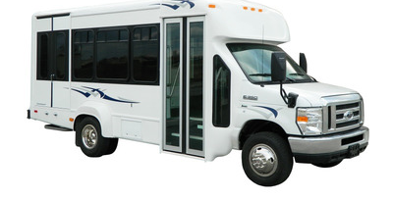
20’ LIGHT TRANSIT VEHICLE

Slide 2
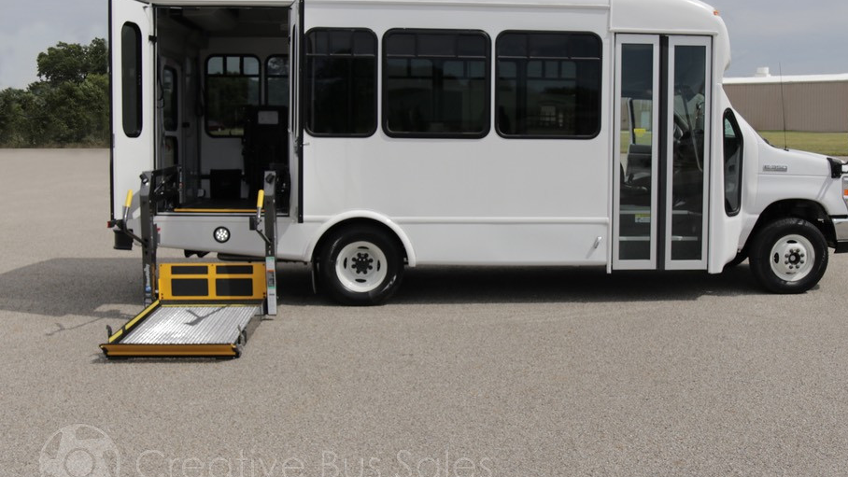
20’LIGHT TRANSIT VEHICLE w/Lift

Slide 3
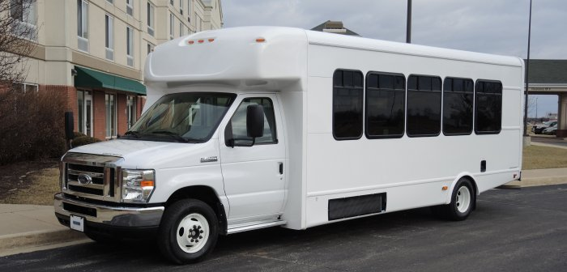
22’ LIGHT TRANSIT VEHICLE

Slide 4
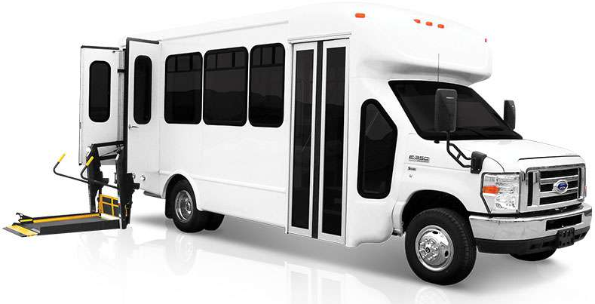
22’ LIGHT TRANSIT VEHICLE-w/LIFT

Slide 5
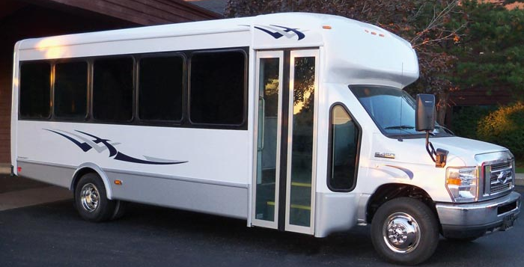
25’ LIGHT TRANSIT VEHICLE

Slide 6
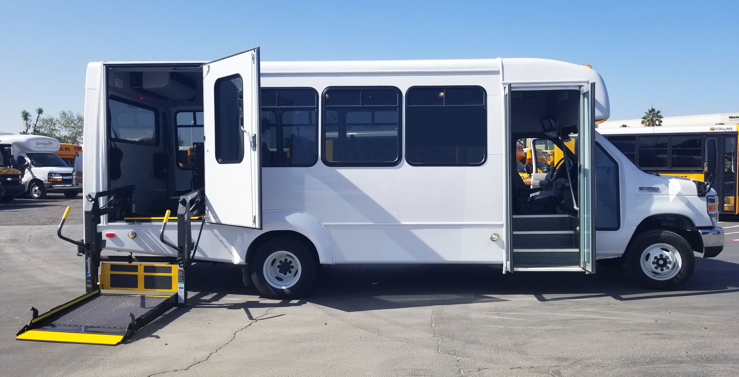
25’ LIGHT TRANSIT VEHICLE-w/LIFT

Slide 7
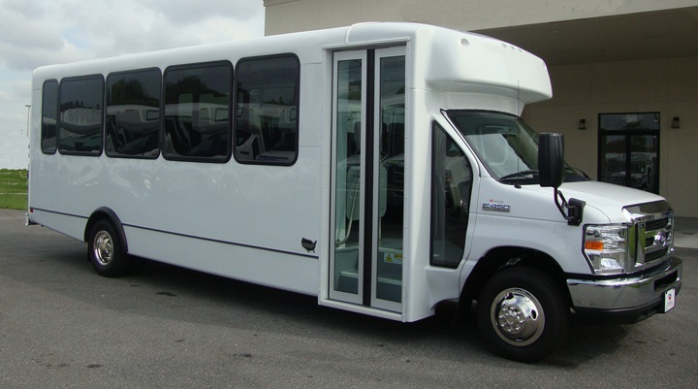
28’ LIGHT TRANSIT VEHICLE

Slide 8
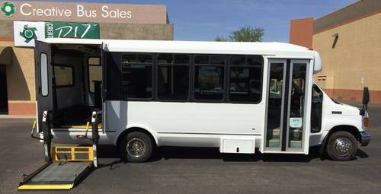
28’ LIGHT TRANSIT VEHICLE-w/LIFT

Slide 9
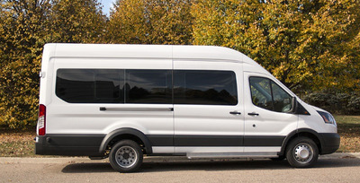
RAISED ROOF VAN

Slide 10
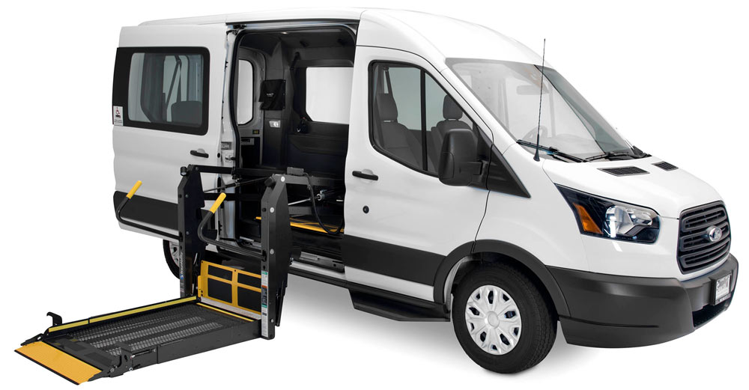
ADA VAN-w/LIFT

